Slide 1



National Technical Honor Society
Your CTE Honor Society

Slide 2
What is NTHS?
We believe in advocating for all skilled career paths and empowering students in seeking skill to build their career and the global workforce.
NTHS honors the achievements of top CTE students, provides close to $300,000 in scholarships annually, and strives to help connect education and industry to build a highly skilled workforce.
We achieve this through the implementation of career development, leadership, service and recognition opportunities -The NTHS Core Four Objectives.

Slide 3

Core Four Objectives
By participating in NTHS, you will utilize the NTHS Core Four Objectives to grow and prepare for your continued education and career.
Career Development
  Resumé development workshops, mock interviews, career fairs, industry speakers, and credential opportunities
Leadership
  Team-building activities, leader training & workshops
Service
  Skill-based service projects, community needs-based projects, annual holiday service projects
Recognition
  Design & distribute nomination letters and induction invitations, assist in coordinating the Induction Ceremonies

Slide 4


Member Benefits
Scholarships
Nearly $300,000 in scholarships are awarded annually to NTHS members. Some of our scholarship partners are:
Letters of Recommendation
Custom letter of recommendation for employment, admission and scholarships.
Membership Kit
Includes your membership certificate, NTHS pin, tassel, decal and graduation seal and portfolio!
Partner Discounts
GEICO
OfficeMax/Office Depot

Slide 5

Member Benefit Add-Ons
Career Readiness Portal
The NTHS Career Readiness Portal is an outstanding member benefit add-on that will help students prepare for their career and continued education. Powered by MajorClarity, a company leading the way in cutting edge career exploration solutions, this tool provides students access to a variety of career readiness resources that have helped hundreds of thousands of students prepare for their next step.
LAPSEN Endorsement
LAPSEN is the premiere support organization for the Law, Public Safety, Corrections and Security Career Cluster (LPSCS) in secondary education. With the opportunity to qualify for the LAPSEN endorsement on their NTHS membership, students in a Law, Public Safety, Corrections and Security (LPSCS) Career Cluster pathway are now getting industry specific recognition for their performance in that field.
LAPSEN

Slide 6
Details for
Chapter Name Here

Slide 7
Criteria for Membership
See Appendix A in the Quick-Start Guide
INSERT CHAPTER SPECIFIC REQUIREMENTS

Slide 8
Dues and Deadlines
INSERT CHAPTER SPECIFIC DUES
INSERT DEADLINE TO PAY DUES

Slide 9
Induction
The (INSERT SCHOOL NAME) NTHS Fall/Spring Induction will take place on:
DATE and TIME
LOCATION

Slide 10




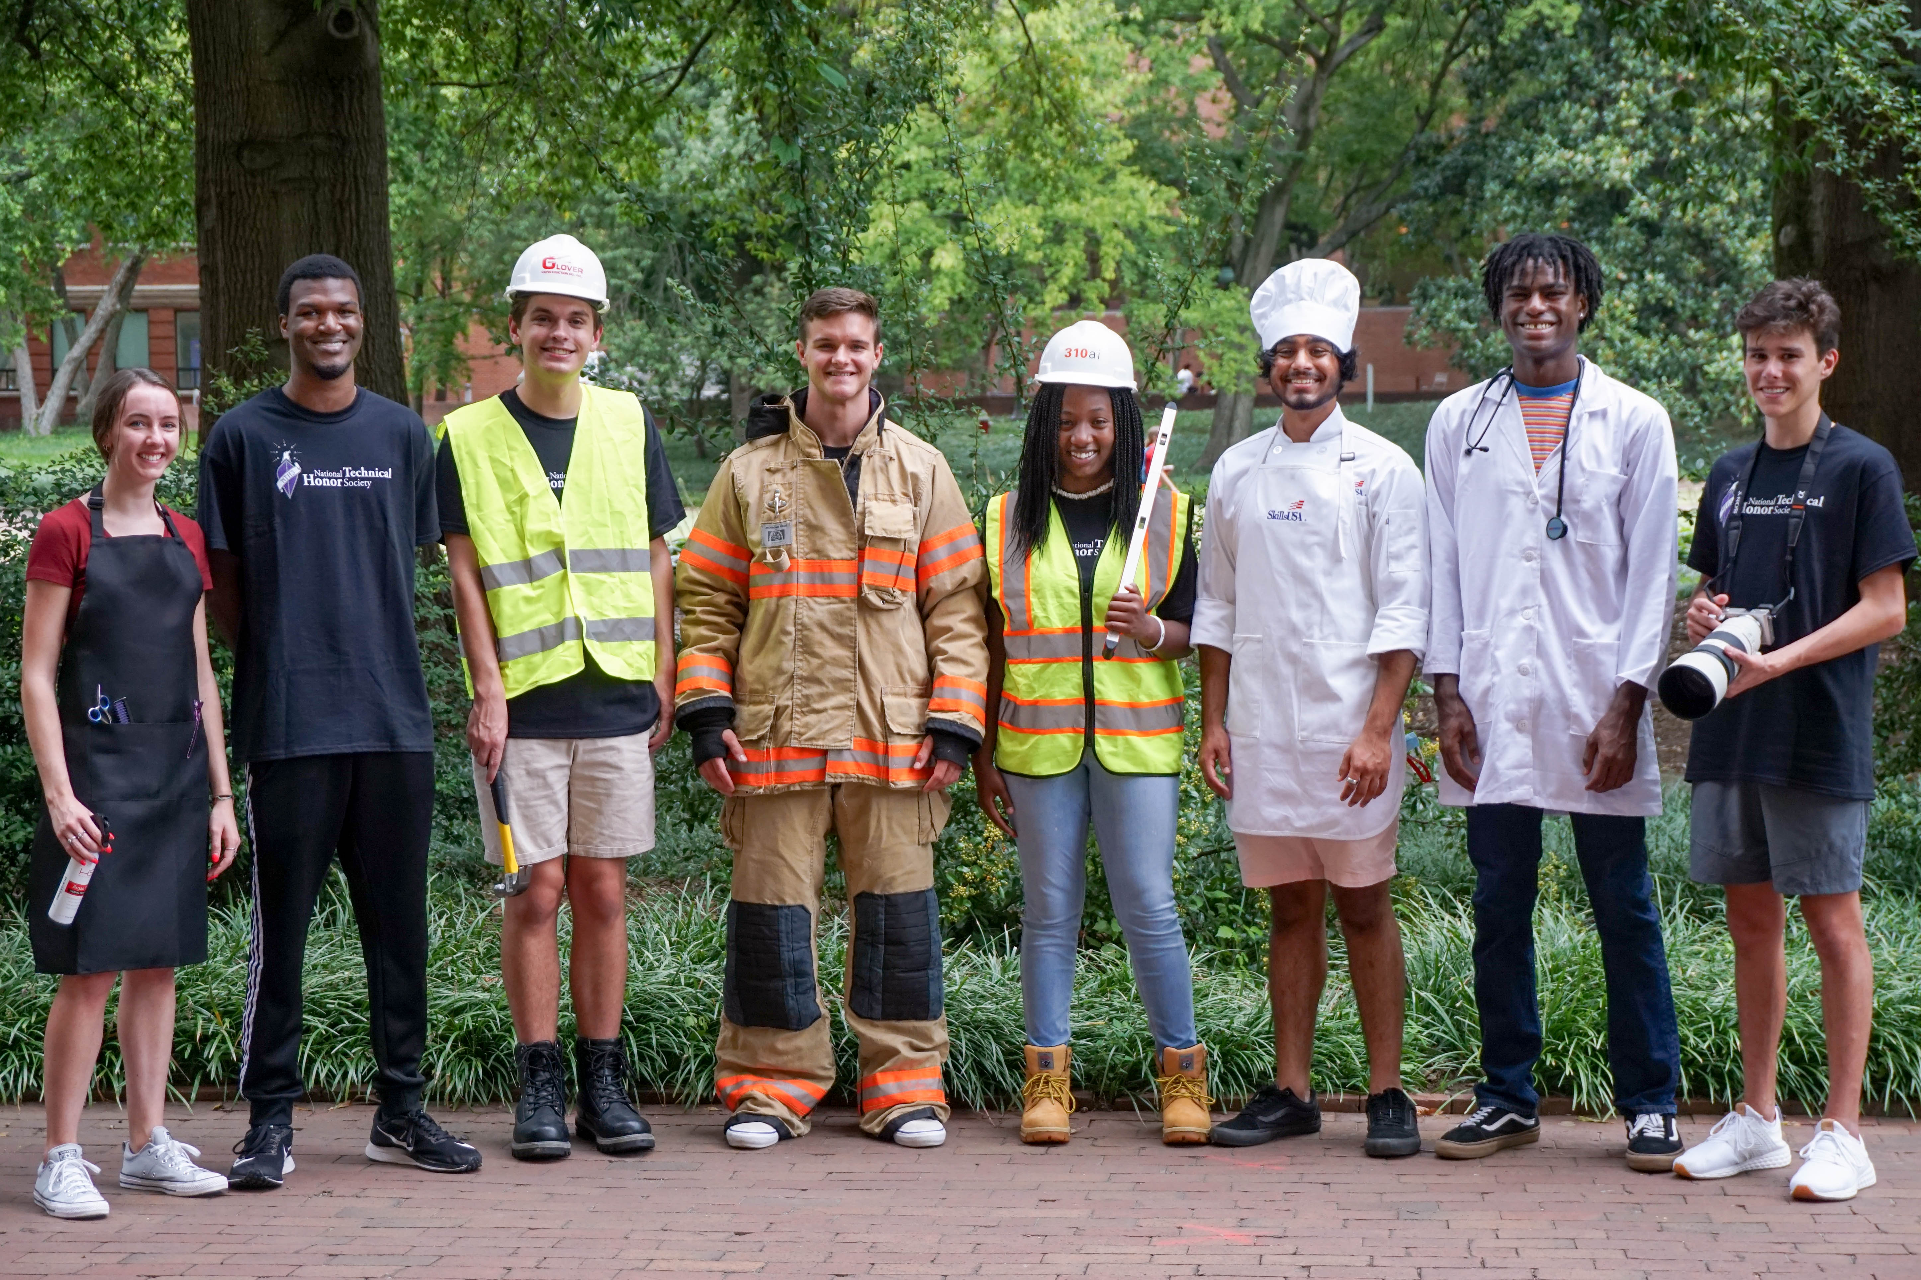
From the classroom to career

Slide 11


Slide 12


