Slide 1
(Insert School Name Here)
2020 Induction Ceremony

Slide 2
Welcome
First Name
Last Name
Title
Organization

Slide 3
Purposes

Slide 4
To reward excellence in
workforce education.

Slide 5
To develop self-esteem, pride and encourage students to reach for higher levels of achievement.

Slide 6
To promote business and industry’s critical workplace values – honesty, responsibility, initiative, teamwork, productivity, leadership, and citizenship.

Slide 7
To help schools build and maintain effective partnerships with local business and industry.

Slide 8
To champion a stronger, more positive image for workforce education in America.

Slide 9
Colors

Slide 10
Silver: Value & Worth
White: Truth & Honesty
Purple: Achievement & Honor

Slide 11
Emblem & Insignia

Slide 14
Motto
Success Favors the Prepared Mind.

Slide 15
Slogan
Excellence in America’s Workforce Begins with Excellence in Workforce Education.

Slide 16
Installation of Officers

Slide 17
President
First Name
Last Name
Trade Area
Class

Slide 18
Vice President
First Name
Last Name
Trade Area
Class

Slide 19
Secretary
First Name
Last Name
Trade Area
Class

Slide 20
Treasurer
First Name
Last Name
Trade Area
Class

Slide 21
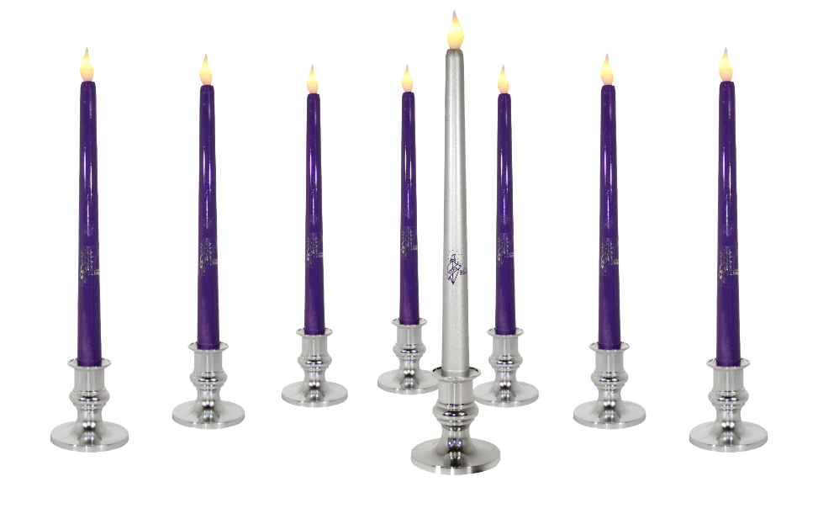
Candle Ceremony

Slide 22
KNOWLEDGE

Slide 23
SKILL

Slide 24
HONESTY

Slide 25
SERVICE

Slide 26
RESPONSIBILITY

Slide 27
SCHOLARSHIP

Slide 28
CITIZENSHIP

Slide 29
LEADERSHIP

Slide 30
Guest Speaker
First Name
Last Name
Title
Organization

Slide 31
Induction Ceremony

Slide 32
Instructions: Copy and past the following slide for as many students as you have before dropping a photo in. That will allow you to easily drop each students photo in their own frame.
First Name
Last Name
Trade Area
Class

Slide 33
First Name
Last Name
Trade Area
Class

Slide 34
Pledge

Slide 35
As a member of the National Technical Honor Society I pledge to maintain the highest standard of personal conduct.
I will apply myself to continue a record of scholastic achievement, and I will strive for excellence in all aspects of my education.
I will invest my talents, my skills, and my knowledge in a career of my own choosing, and shall always endeavor to uphold my obligations as a citizen of my community and my country.

Slide 36
Closing
First Name
Last Name
Title
Organization

Slide 37
Welcome New Members!

